Slide 1
Catalyst Predevelopment Fund
INVESTING IN INCLUSIVE REGIONAL CAPACITY
CATALYZING INVESTABLE COMMUNITIES
BRINGING COMMUNITY VISION TO LIFE
Notes:
Come back to the intention

Slide 2
Comprehensive Approach
Create near-term pathways for investment into communities while continuing to invest in inclusive economic development and regional governance
TRANSFORM GOVERNANCE
Create an enabling environment to co-create
shared priorities in collaboration with diverse stakeholder groups.
CATALYZE PROJECTS
Develop a pipeline of projects aligned with community priorities and CERF program objectives.
BRING VISION TO LIFE
Leverage historic funding opportunities to construct ready-to-go projects developed through the planning and pre-development phases.
Notes:
We know that federal funders are looking for this deep community engagement and capacity building… makes our regions really competitive for this money

Slide 3
OBJECTIVE Continue supporting communities in coming to the table
EQUITY & INCLUSION | Incorporate community voice in an inclusive decision-making process.
CLIMATE & SUSTAINABILITY | Support the state’s shift to a carbon-neutral economy by prioritizing funding for projects and programs that support climate and equity goals.
ECONOMIC PROSPERITY FOR ALL | Create good-paying jobs and support pathways to high quality jobs.
Notes:
The opportunity

Slide 4
OBJECTIVE Catalyze Investable Communities Maximize investment opportunities into communities while ensuring alignment with CERF objectives of inclusion, equity, and sustainability
Notes:
The opportunity

Slide 5
Maximize Investment into Communities
Align timeline with historic federal and state funding opportunities
$190 Billion in Federal Funding for California
$48 Billion*
California Climate Commitment
3-Year Horizon*
$41.9 Billion*
Infrastructure Investment and Jobs Act
2026 Horizon*
~$390 Billion*
Inflation Reduction Act
2026 Horizon*
~$52 Billion*
Chips & Science Act
2026 Horizon*
Notes:
We know that federal funders are looking for this deep community engagement and capacity building… makes our regions really competitive for this money

Slide 6
Supporting a new generation of community-led investments
Deficit of ready-to-go projects
Few ready-to-go projects; $50 million available for CERF pilot projects but $39 million funded
Need for capacity and
pre-development
Many disinvested communities do not have a portfolio of ready-to-go projects
Current pipeline not aligned with state goals
Governor’s recent infrastructure report shows current pipeline of ready-to-go projects not aligned
Notes:
Our two data points here.
Pilot projects: only $39 million
Not a large enough qualified pool of projects to dispense all funding
Report: no pipeline of projects in DAC communities (Louise at UC Berkeley)
Given the circumstances, our objective is to have all of our strategies on the table -
So we want to make sure that as we are progressing in this process, we are positioning regions to pursue these near term funding opportunities

Slide 7
FEEDBACK RECEIVED
Across comment letters and workshop sessions
1. 300 organizations and individuals statewide 2. 140 unique pieces of feedback
Notes:
The opportunity

Slide 8
What we heard
THEME | OPPORTUNITIES FOR IMPROVEMENT | CATALYST 2.0
Administrative | Transparency, expedient contracting, extended deadlines, and retention of funds in regions if not used | Application no more than eight pages
Equity and Disinvested Communities | Allocation of funds not proportionate to size of regions Standard definitions and metrics of equity and other key program considerations | Ensure broad access to inclusive economic development in each region, while allowing discretion on most equitable use of funds to HRTCs Evaluation metrics currently under development
State Process and Communications | Make materials accessible and available in multiple languages Need for clear terminology | Program factsheet and updated FAQs will be made available in multiple languages
Catalyst Program Design | Funding amount too large for some regions to liquidate and takes too much away from implementation phase Catalyst should support HRTC activities and planning | Decrease to $14 M per region, including up to $2 million for HRTC operations
Catalyst Funding Buckets | Need for flexibility in buckets | Less prescription in required funding categories
Notes:
The opportunity

Slide 9
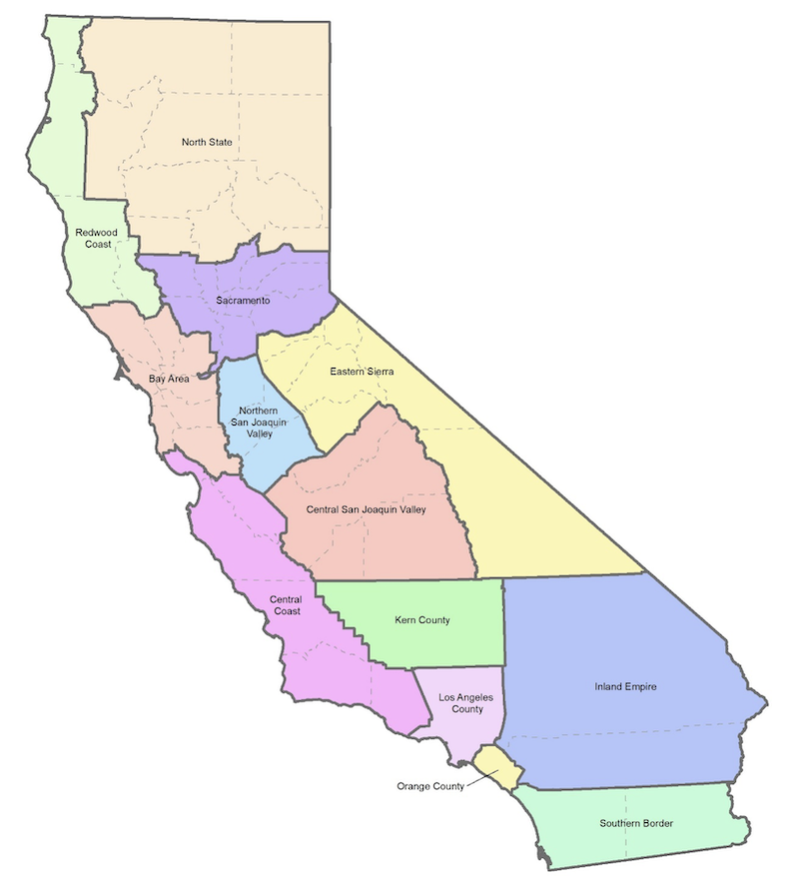
Catalyst 2.0
$14 million per region to bridge inclusive economic planning with project and program implementation
Up to $2 million in HRTC operations
Up to $1.5 million towards Sector Investment Coordinators
Up to $9 million for project pre-development activities
Up to $1.5 million towards grant administration and compliance (Fiscal Agent overhead)
Notes:
Overarching timeline & process

Slide 10
CERF’s three phases
Creating pathways for investment that will bring bottom up, regionally governed economic blueprints to life – creating good-paying jobs, prosperous communities, and a clean energy economy

Slide 11
Catalyst Timeline
Planning Phase: March 2023-September 2024
Early September
Final guidelines and notice of funding availability
Mid-November
Applications due
Predevelopment: September 2023-September 2026
Fall
Catalyst 2.0 Webinar
May 2024
Awards made
Implementation phase
Notes:
Timeline:

